Slide 1
214450 : Computer Graphics
Dr. S. C. Dharmadhikari

Slide 2
Course Objectives
Understand the foundations of computer graphics: hardware systems, math basis, light and color.
Understand the complexities of modeling realistic objects through modeling complex scenes using a high-level scene description language.
Become acquainted with some advanced topics in computer graphics. The student should gain an expanded vocabulary for discussing issues relevant to computer graphics (including both the underlying mathematics and the actual programming).
Continued …

Slide 3
The student should gain an appreciation and understanding of the hardware and software utilized in constructing computer graphics applications.
The student should gain a comprehension of windows, clipping and view-ports in relation to images displayed on screen.
The student should gain an understanding of geometric, mathematical and algorithmic concepts necessary for programming computer graphics.

Slide 4
Agenda
UNIT – I BASIC CONCEPTS
UNIT – II POLYGONS AND GRAPHICAL TRANSFORMATIONS
UNIT – III 3D TRANSFORMATIONS AND PROJECTIONS
UNIT – IV SEGMENTS, WINDOWING AND CLIPPING
UNIT – V SHADING, ANIMATION AND GAMING
UNIT – VI CURVES AND FRACTALS

Slide 5
Examination Scheme
Online : 25 + 25 = 50 Marks Optional
END-SEM : 50 Marks Descriptive
214456 : COMPUTER GRAPHICS LABORATORY
Term Work : 25 Marks
Practical : 50 Marks

Slide 6
Major Influences
M Paulin Baker ,”Computer Graphics”, Pearson Education.
Steven Harrington ,”Computer Graphics A Programming approach ”,Tata McGraw Hill.
D. Hearn, M. Baker, “Computer Graphics – C Version”, 2nd Edition, Pearson Education, 2002, ISBN81 – 7808 – 794 – 4.

Slide 7
Computer Graphics ?

Slide 8
BASIC CONCEPTS

Slide 9
Agenda
Part I | Introduction to Computer Graphics, Basics of graphics systems, Raster scan & Random scan displays, basic display processor
Part II | Display Files: display file structure, algorithms and display file interpreter. Primitive operations on display file
Part III | Plotting Primitives: Scan conversions, lines, line segments, vectors, pixels and frame buffers, vector generation
Part IV | Line drawing Algorithms: DDA, Bresenham Circle drawing Algorithms: - DDA, Bresenham
Part V | Character Generation: Stroke Principle, Starburst Principle, Bit map method, Introduction to aliasing and anti-aliasing

Slide 10
Part I : Graphics Primitives.
Computer Graphics : It deals with pictures and images.
It makes a computer capable of displaying and manipulating pictures.
For example, laser printers , plotters, monitor .

Slide 11
Web Definitions
[i] Computer-generated image data created with help from specialized graphical hardware and software.
[ii]Visual representations of data displayed on a monitor made on a computer.
[iii]The use of a computer to produce and manipulate pictorial images on a video screen
[iv]An art of drawing pictures, lines, charts, etc using computers with the help of programming
* Applications ……. Gaming, Animation, Entertainment, Education.

Slide 12
Some Popular Applications…..
VFX
Visual Effects (abbreviated VFX) is the processes by which imagery is created or manipulated outside the context of a live action shot in film making.
- Simply a visual effect is the ideal utilization of computers to insert and remove special effects or enhancements that wasn’t initially inside the shot.

Slide 13
Commonly Used Software and Techniques for Visual Effects in Films and Games
3Ds MAX
MAYA
Zbrush
Mudbox
Modo
SoftImage
Cinema4D
Photoshop
GIMP
Cyberlink
Adobe illustrator …

Slide 14
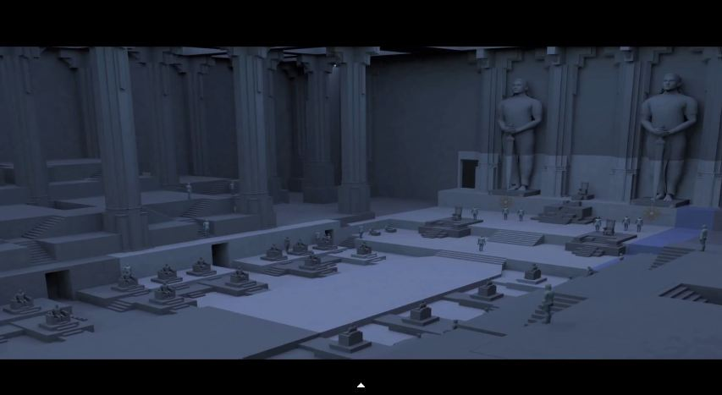
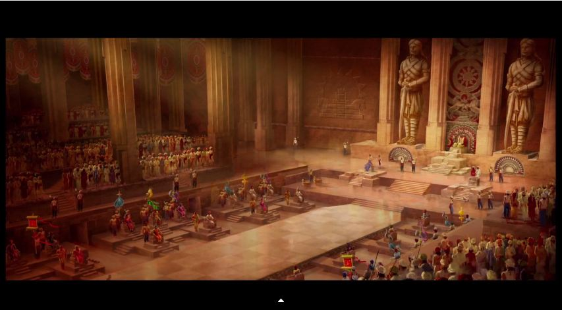

Slide 15
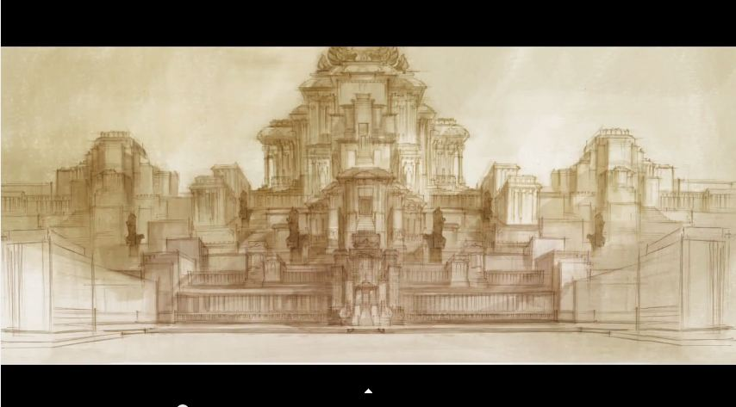
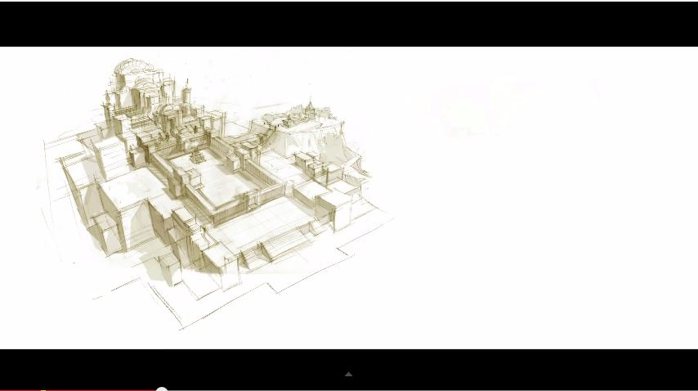

Slide 16
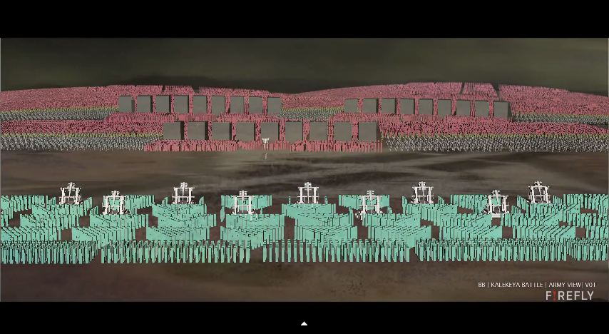
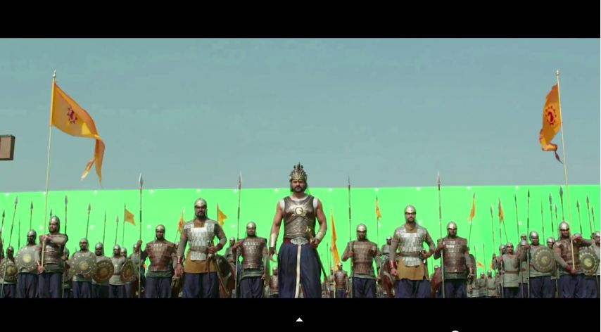

Slide 17
More than 4,500 VFX shots in the movie.
This huge amount of VFX shots are new record in Indian cinema.
Makuta VFX
Makuta is an Indian visual effects and animation company based in Santa Clara, CA with branches in Hyderabad, India and Universal City, CA.

Slide 18
Architecture Of A Graphics System
Display Processor Memory
Frame Buffer
Video Controller
Monitor
Monitor
CPU
Display Processor
System Memory
System Bus

Slide 19
Refreshing :
D.A. circuitry repeatedly reads information from DP memory and transfers it onto screen so as to make the image displayed on screen steadily and clearly.
[ 50 to 70 times a second ]
Refresh Rate
Low refresh rate causes flickering.

Slide 20
Types Of D.A.
Monochrome Adapter [ MA ]
Hercules Adapter [ HA ]
Color Graphics Adapter [ CGA ]
Enhanced Graphics [ EGA ]
Multicolor Graphics Adapter [ MCGA ]
Video Graphics Adapter [ VGA ]
Super Video Graphics Array [SVGA ]
Extended Graphics Adapter [XGA ]

Slide 21
Different Modes
1> Character mode
Programs running in character mode are severely limited.
In character mode, the display screen is treated as an array of blocks, each of which can hold one ASCII character.
2> Graphics mode.
Programs that run in graphics mode can display an unlimited variety of shapes and fonts
In graphics mode, the display screen is treated as an array of pixels. Characters and other shapes are formed by turning on combinations of pixels.

Slide 22
Graphics Primitives
Pixel : Picture Element, a pixel is a single point in a graphic image.
Arranged in rows and columns. The pixels are so close together that they appear connected.
The number of bits used to represent each pixel determines how many colors or shades can be displayed.
Resolution : The quality of a display system largely depends on its resolution i.e. how many pixels it can display. It refers to the sharpness and clarity of an image.
For example, a 640-by-480 pixel screen is capable of displaying 640 distinct dots on each of 480 lines, or about 300,000 pixels.

Slide 23
Types
There are two kinds of displays–
1) raster (composed of pixels) and
2) vector (composed of paths).

Slide 24
RASTER GRAPHICS
On a computer monitor, images are nothing more than variously colored pixels. Certain kinds of image-file formats record images literally in terms of the pixels to display.
Raster images are more commonly called bitmap images.
A bitmap image uses a grid of individual pixels where each pixel can be a different color or shade. Bitmaps are composed of pixels.
A bitmap become jagged as it is scaled up.
The jagged appearance of bitmap images can be partially overcome with the use of "anti-aliasing".

Slide 25

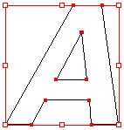
Raster( Bitmap ) Image | Vector Image

Slide 26
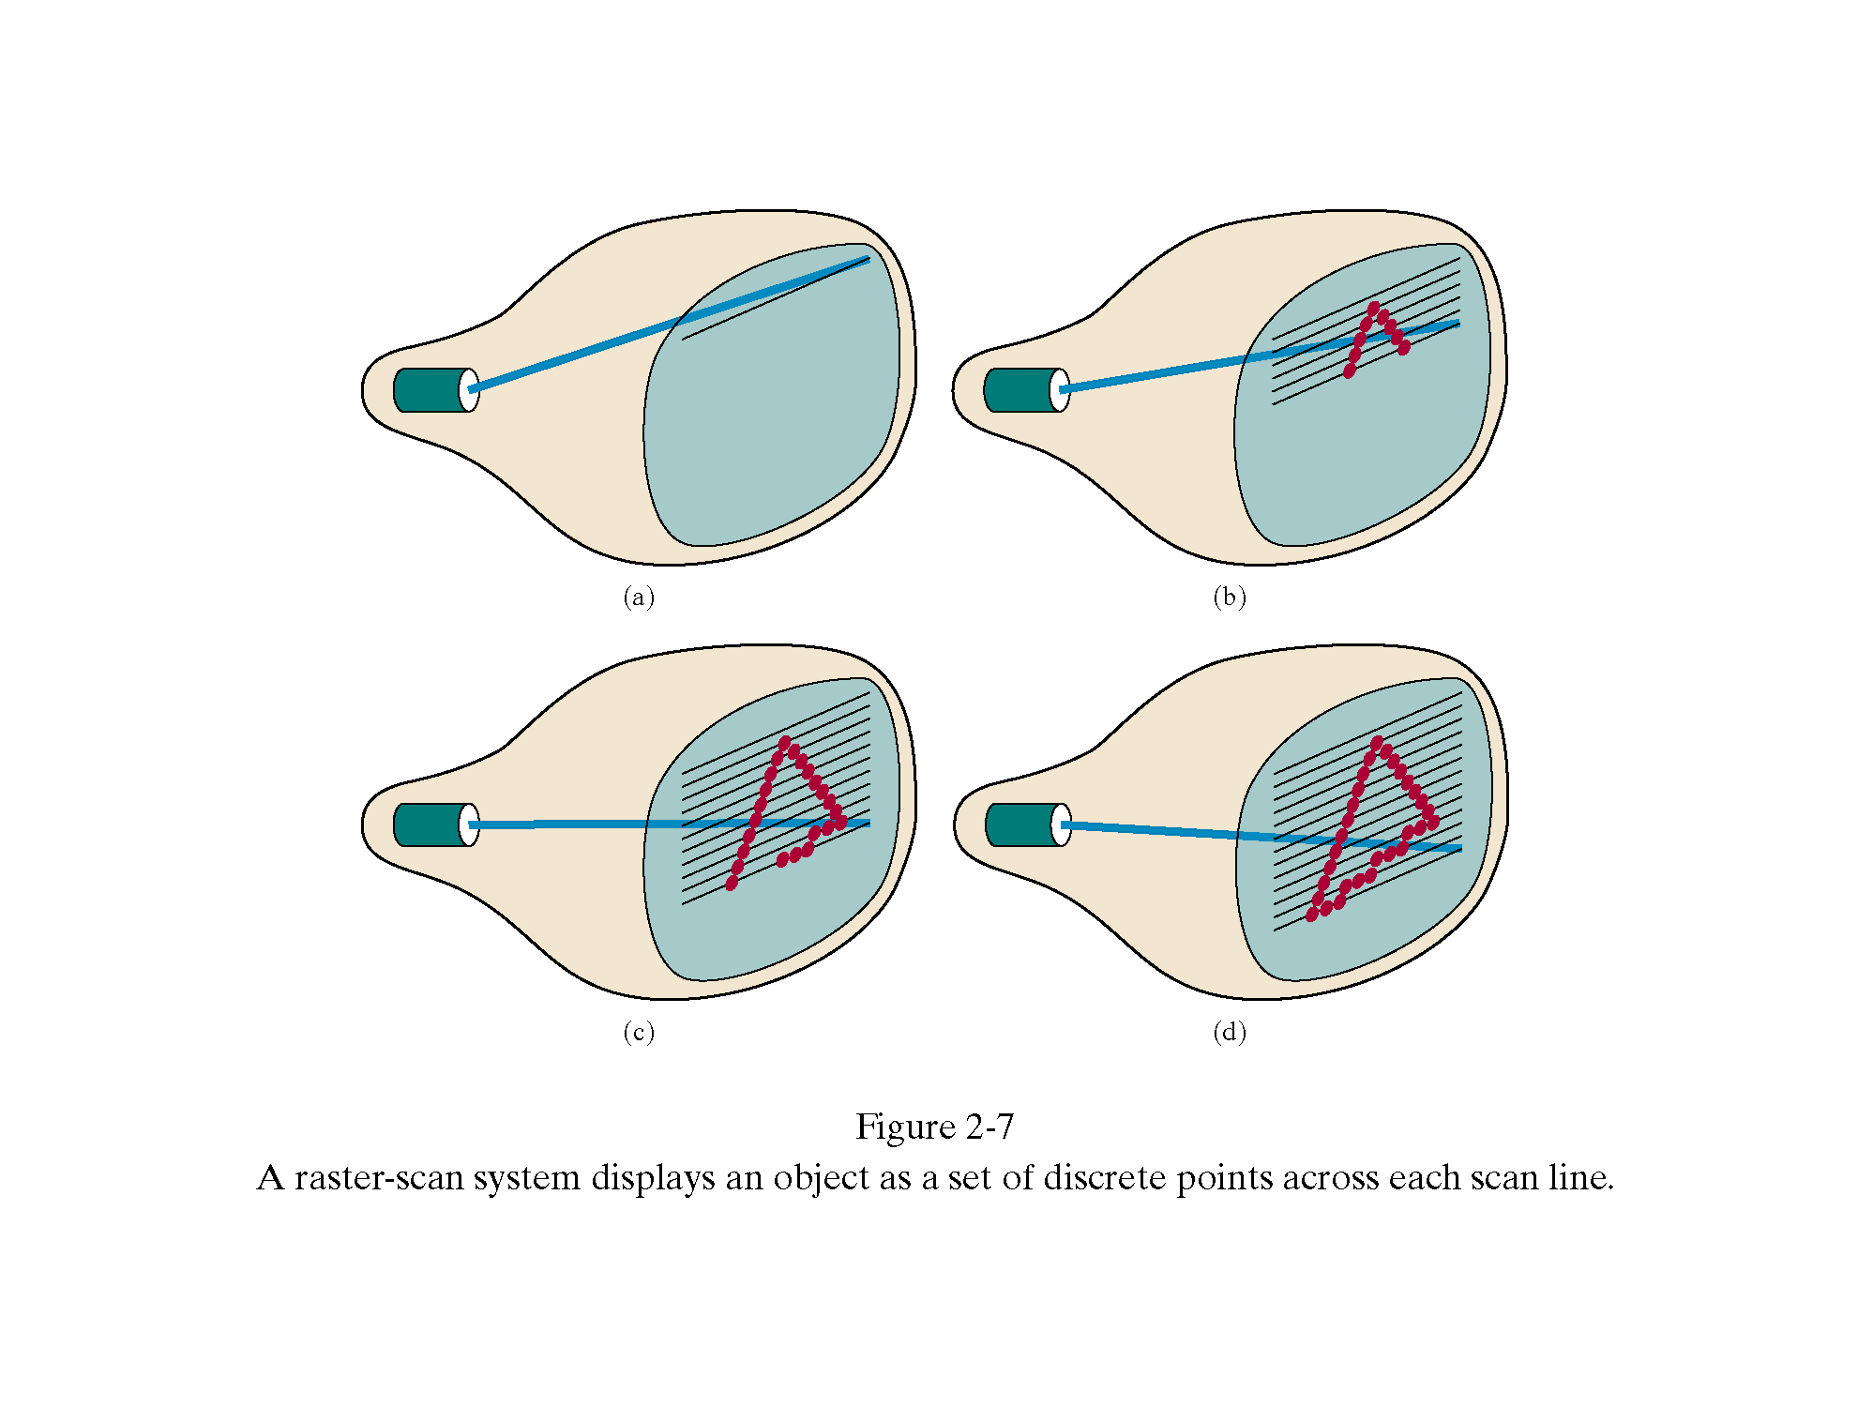

Raster Scan Systems
Draw one line at a time

Slide 27
Anti-aliasing is the application of subtle transitions in the pixels along the edges of images to minimize the jagged effect.
One can edit the image only by altering the pixels directly with a bitmap editor.
Photoshop and Paint Shop Pro are two of the most popular bitmap editors.

Slide 28
VECTOR GRAPHICS ( Random Scan )
Vector image files record images descriptively, in terms of geometric shapes. These shapes are converted to bitmaps for display on the monitor.
Vector graphics use mathematical relationships between points and the paths connecting them to describe an image. Vector graphics are composed of paths.
Vector images are easier to modify, because the components can be moved, resized, rotated, or deleted independently.
PostScript is a popular vector format for printing, but so far Macromedia's Flash is the closest thing to a standard vector format on the Web.

Slide 29
Designed for line-drawing applications, such as architectural and engineering layouts, and they cannot display realistic shaded scenes.
Refresh rate on a random-scan system depends on the number of lines to be displayed on that system. Picture definition is now stored as a set of line-drawing commands in an area of memory referred to as the display list, refresh display file, vector file, or display program.
To display a specified picture, the system cycles through the set of commands in the display file, drawing each component line in turn.
After all line-drawing commands have been processed, the system cycles back to the first line command in the list.
Random-scan displays are designed to draw all the component lines of a picture 30 to 60 times each second, with up to 100,000 “short” lines in the display list.

Slide 30
